Slide 1
Pantry Pal
MET CS:521-Information Structures with Python
By Harini Saravanan
BU ID: U33572460
-Prof. Ed Orsini

Slide 2
About Pantry Pal
This project is a kitchen assistant app that suggests recipes based on ingredients in the user's pantry. It includes functionalities for finding recipes from a predefined database, adding new ingredients, and optionally searching for recipes online using web scraping.

Slide 3
WHY THIS TOPIC?

Slide 4
As an international student living away from home, I’ve had to learn cooking on my own, which has been both exciting and challenging. One of the biggest problems I face daily is figuring out what to cook with the ingredients I have in my pantry. Often, I’m left wondering how to make the best use of them without wasting food. That’s when I thought—why not create a solution for this problem? This led to Pantry Pal, a project that not only helps me but also addresses a common issue many others might face, turning a personal challenge into a practical, data-driven solution.

Slide 5
Key Features
Ingredient-Based Recipe Finder:
Suggests recipes from a predefined database using user-input ingredients.
Ingredient Storage:
Saves user ingredients locally for convenience and persistence.
Online Recipe Search:
Fetches recipes from the web using Spoonacular API for more options.
overview
User-Friendly Interface:
Simple command-line interface with step-by-step interaction.

Slide 6


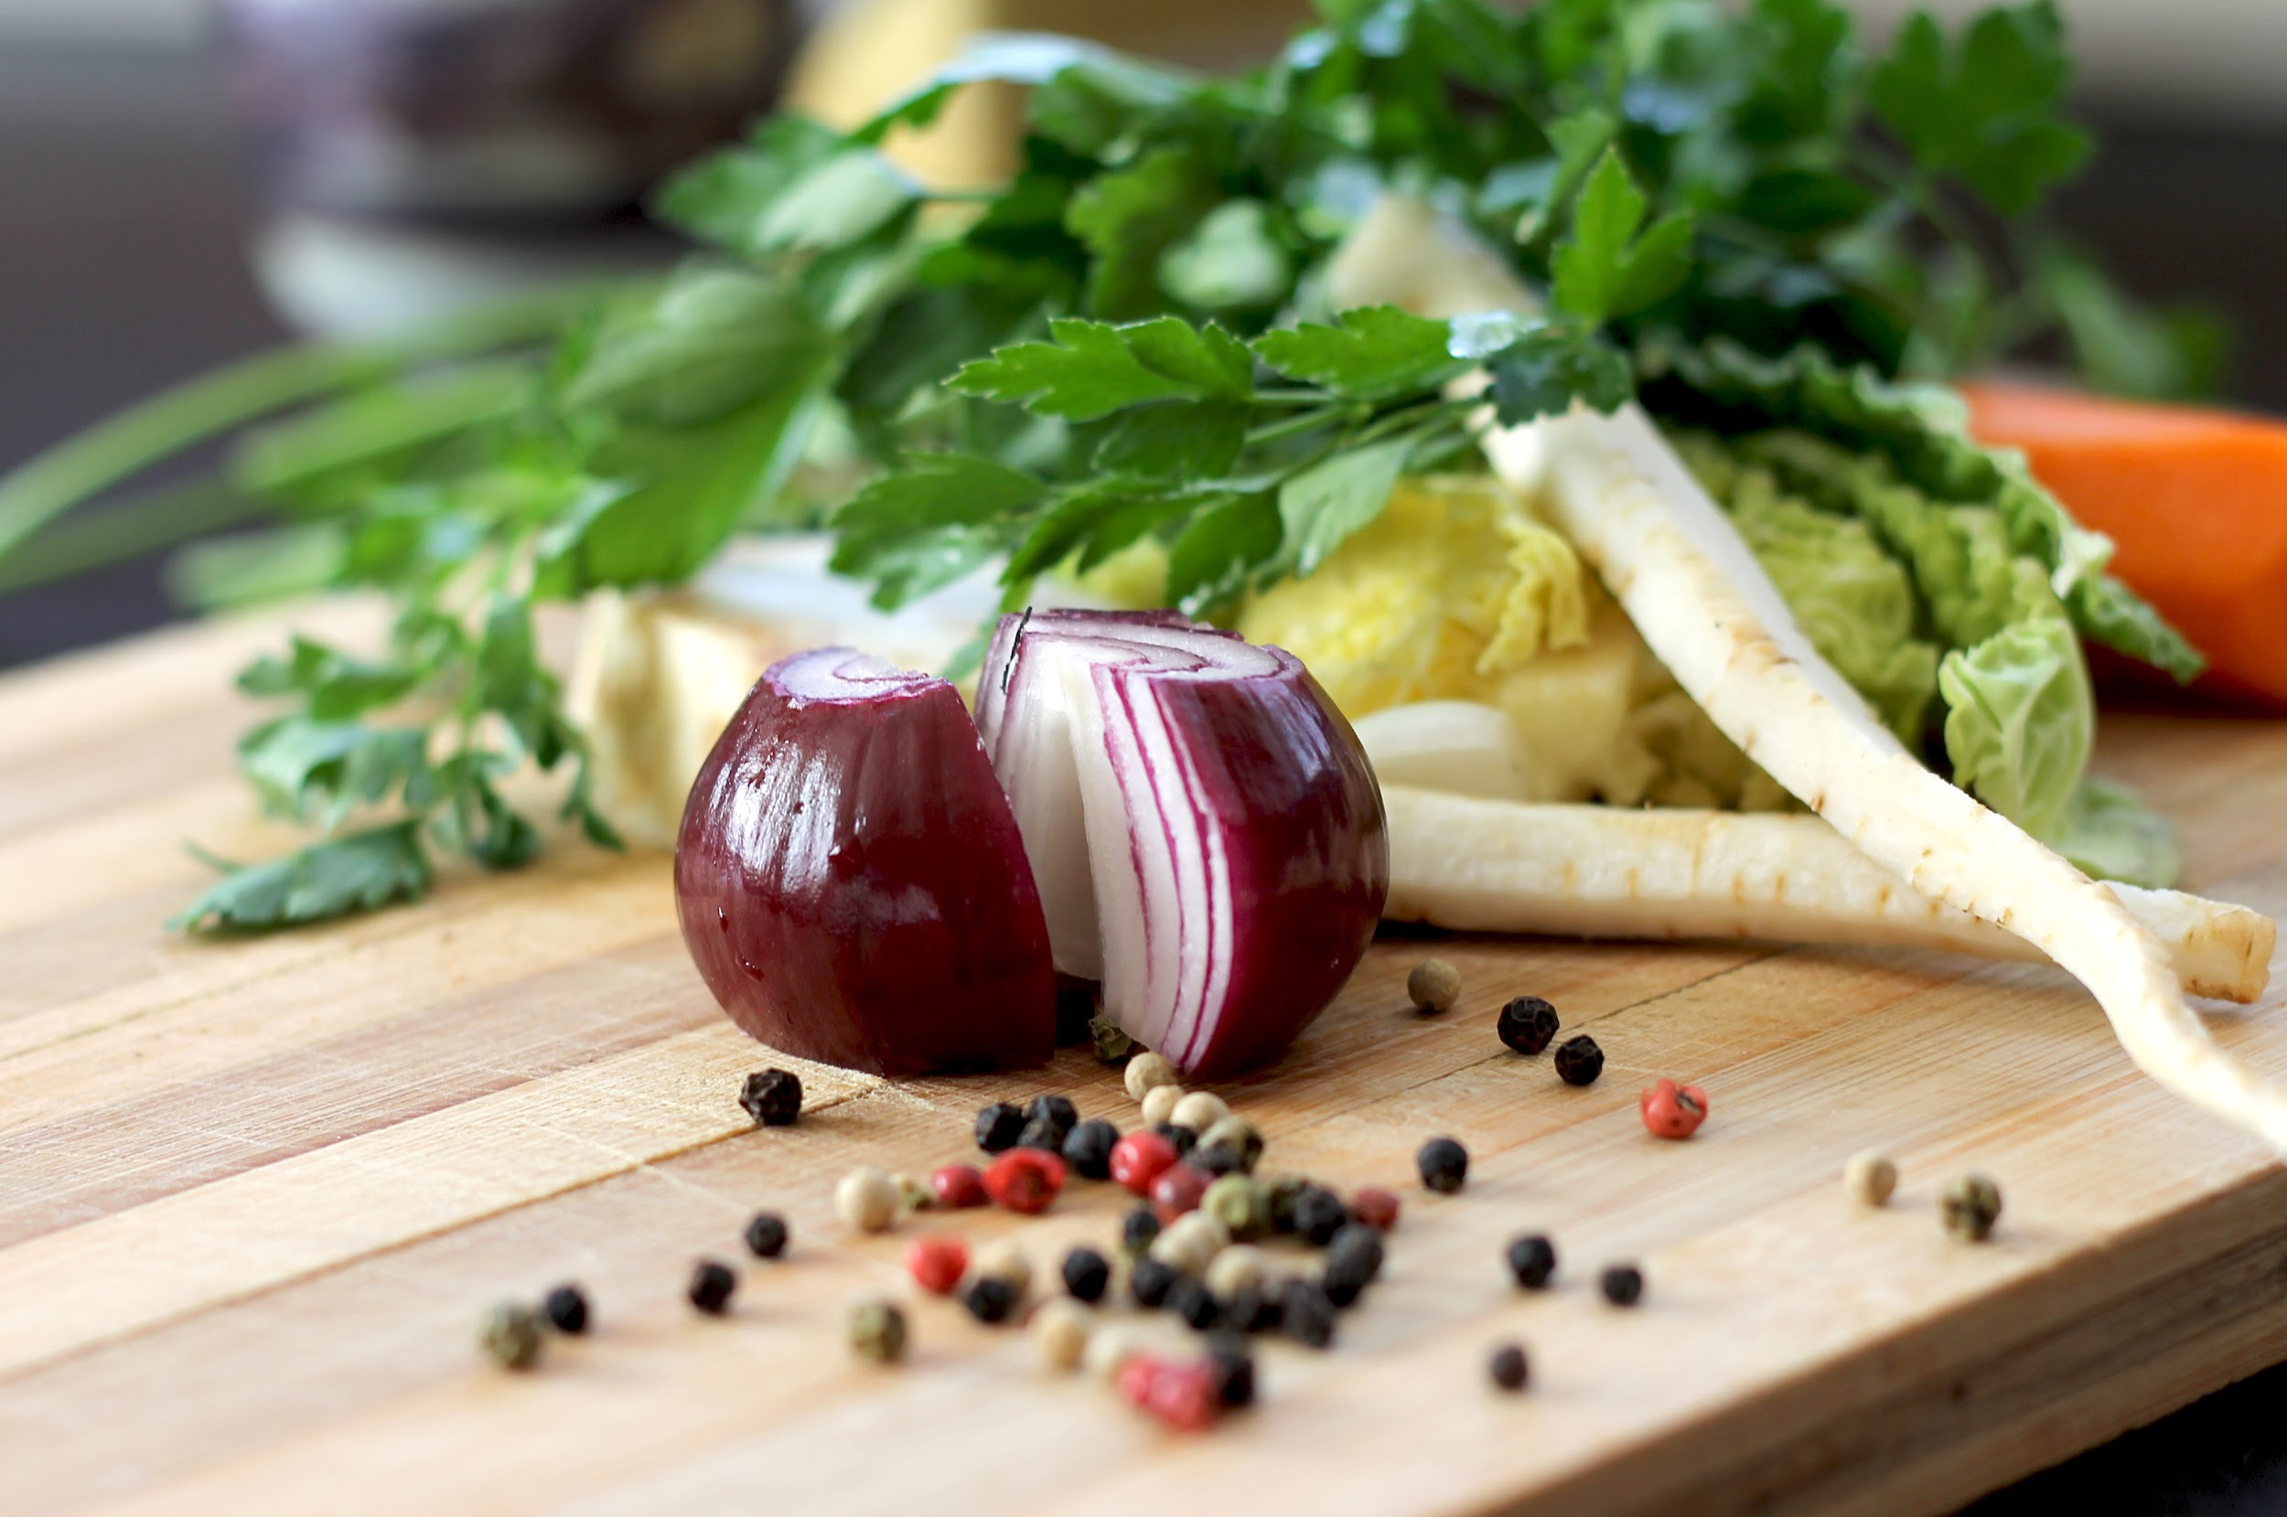

Let’s look at the workflow

Slide 7
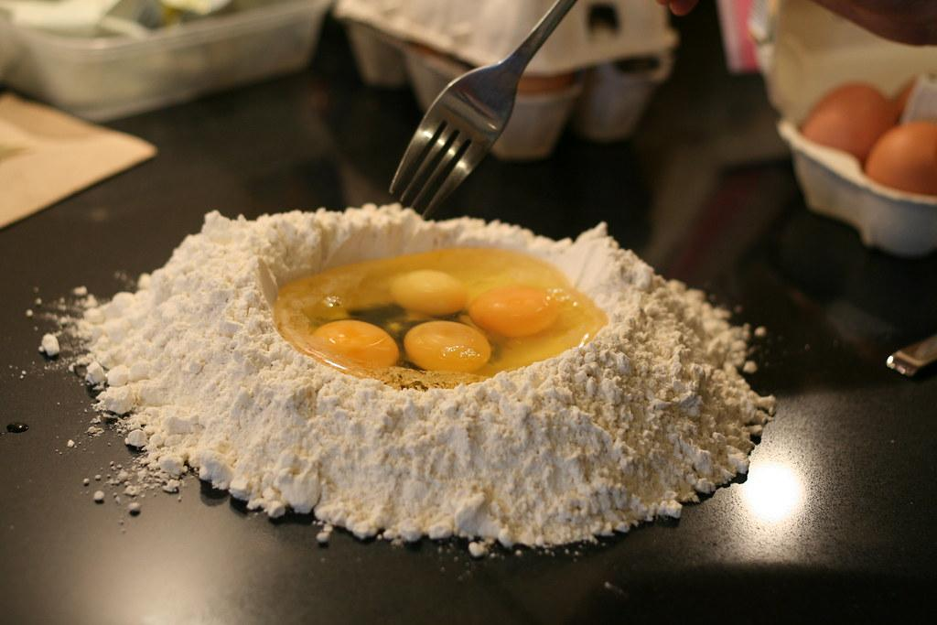
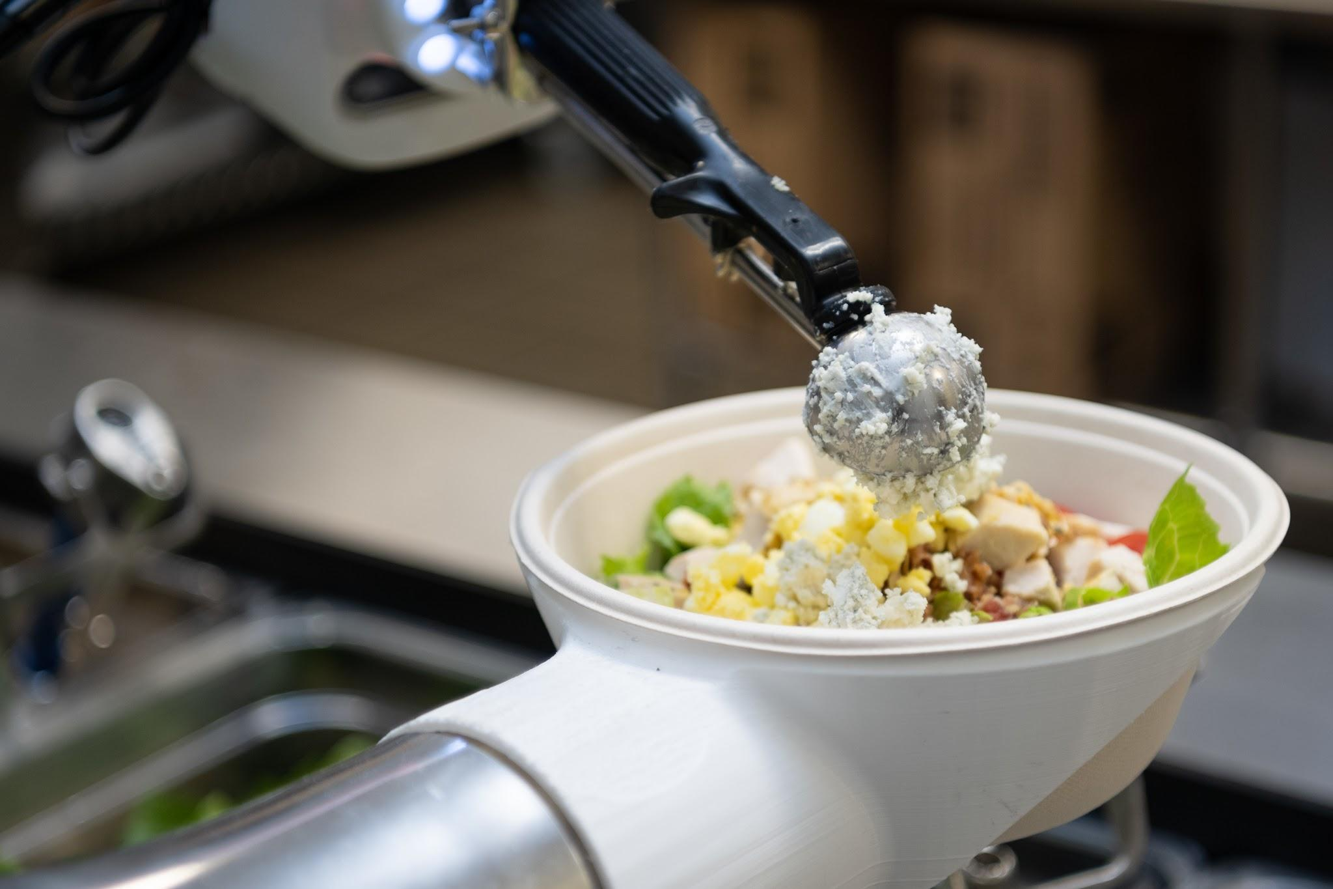
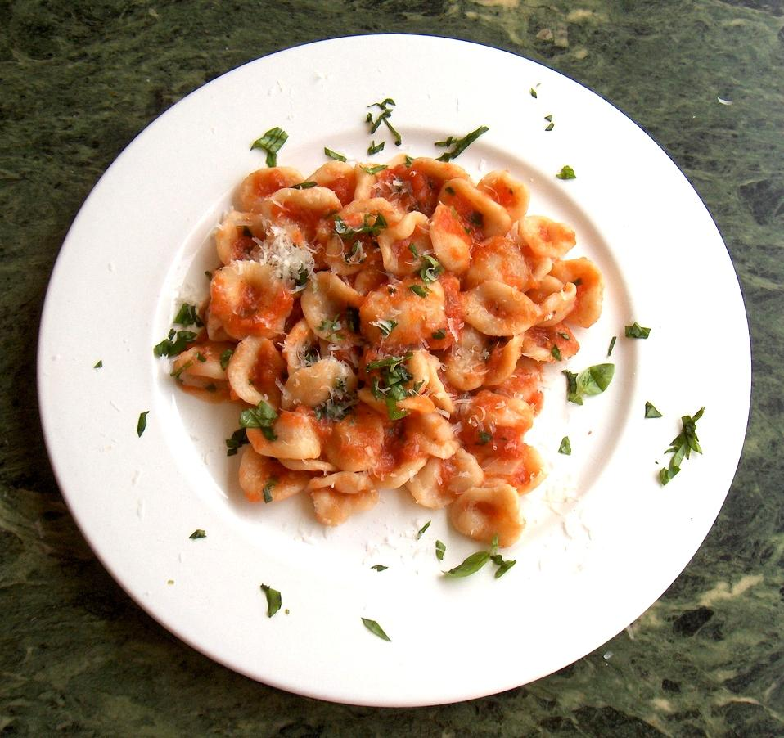
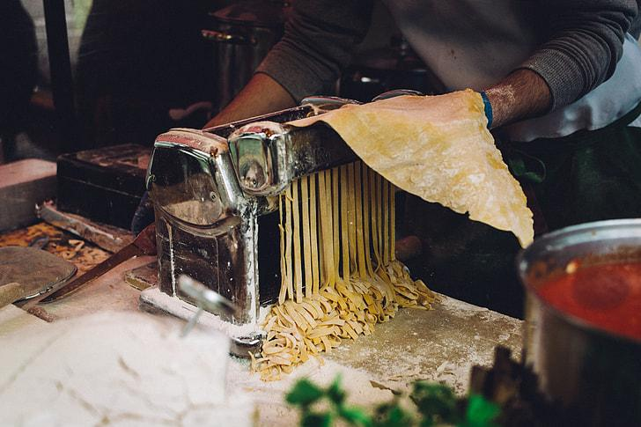
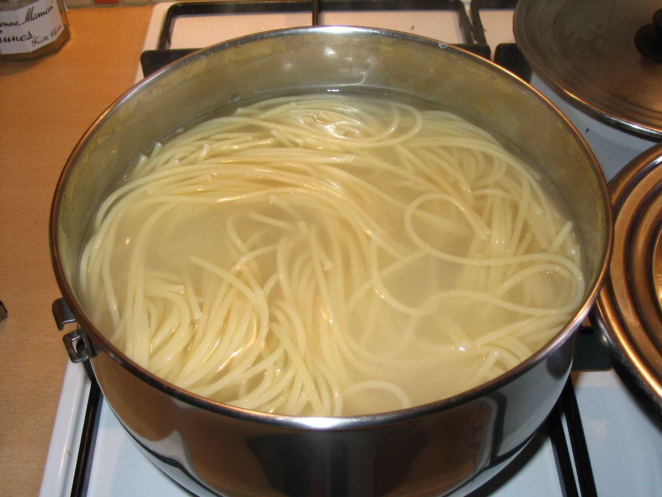
User Input
Optional Online Search
Output
Save Ingredients
Local Recipe Search

Slide 8
CODE ARCHITECTURE
main.py
Main Components
pantry_class.py
attributes
_ingredients
Class Designs
recipe_database
find_recipes
key methods
add_ingredient
scrape_recipes

Slide 9

RECIPE DATABASE
Structure:
Stored as a dictionary in pantry_class.py
Why Chosen?
Covers common recipes with simple ingredients.
Easily extendable for future use.

Slide 10
Example
RECIPE | INGREDIENTS
Pasta | pasta, tomato, cheese
Omelette | egg, milk, cheese
Salad | lettuce, tomato, cucumber
Pizza | flour, tomato, cheese, basil

Slide 11
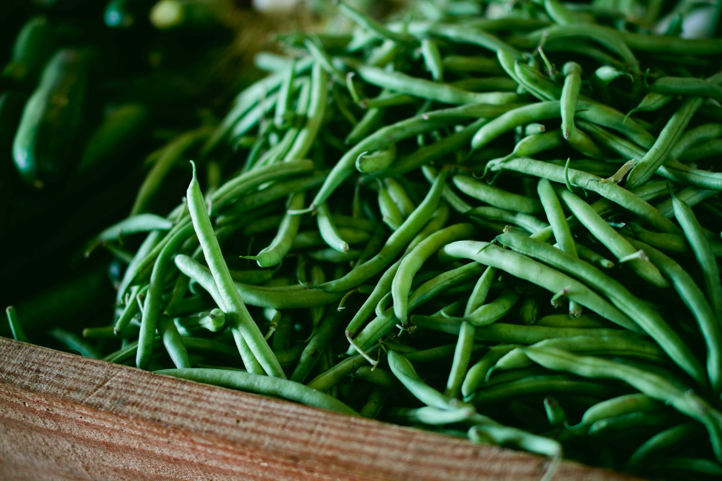
Spoonacular API Integration
PURPOSE:
Enhances Pantry Pal with online recipe search functionality.
WORKFLOW:
Sends user-input ingredients to Spoonacular API.
Fetches recipes and displays them to the user.
ADVANTAGES:
Access to a large recipe database.
Dynamic and real-time suggestions.

Slide 12
DEMO

Slide 13

Advantages
Time-Saving: Quickly find recipes based on available ingredients.
Accessible: User-friendly command-line interface.
Scalable: Easily expandable recipe database and API integration.
Versatile: Works offline with local recipes and online for extended options.

Slide 14

FUTURE ENHANCEMENTS
GUI Integration:
Replace command-line interface with a graphical application.
Advanced Features:
Suggest ingredient substitutions.
Rank recipes based on user preferences.
Recipe Uploads:
Allow users to add and share their recipes.

Slide 15

CONCLUSION
Pantry Pal simplifies cooking by connecting your pantry to smart recipe suggestions.
A perfect companion for anyone looking to save time and reduce food waste.
Harini Saravanan hsaravan@bu.edu

